Slide 1


28 May 2021
Radford Burger

Slide 2

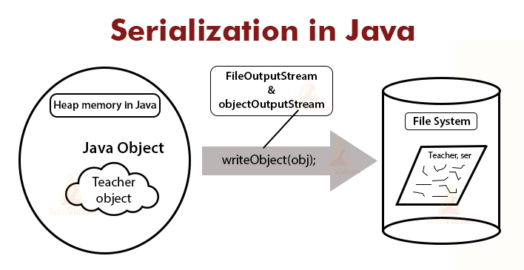
File-handling (serialized files)

Slide 3
What is a serialized file?
  Sequential text file:
  Values are written/stored as separate and independent.
  Programmer imposes a record structure with newline character after each set of related values.
  Serialized file:
Read/write an entire object from/to a file
The objects that we are reading/writing are serialized objects

Slide 4

What is a serialized file?
  Sequential text file:
  Simple text files, readable by humans.
  Serialized file:
The file containing the serialized data is in binary format, not readable by humans.

Slide 5
Writing to a serialized file (serialization)
  The worker class has to be modified so that objects of this class can be serialized.
The class must implement the interface Serializable which is defined in the package java.io.
  import java.io.*;
  public class Account implements Serializable {
interface contains no methods, therefore called a tagging interface
The rest of the statements in the class remain the same as before, constructors, get methods, set methods, toString,...

Slide 6
Writing to a serialized file (serialization)
When writing serialized objects we use stream objects.
  ObjectOutputStream class defined in package java.io
The argument to the ObjectOutputStream constructor is a FileOutputStream object (also define in package java.io)
private ObjectOutputStream output ;
output = new ObjectOutputStream( new FileOutputStream( "clients.ser" ) );
When constructing the object streams, the IOException has to be handled.
Files containing serialized objects generally have a .ser extension

Slide 7
Writing to a serialized file (serialization)
Construct an serialized object, initialize the instance variables:
    Account accRecord;
    accRecord = new Account(“Jon”, “Cheque”, 15000.75);
Use the writeObject method from the ObjectOutputStream class to write the object to the file:
    output.writeObject(accRecord);
    This method could throw an IOException, which must be caught.

Slide 8
Writing to a serialized file (serialization)
Once all the objects have been written to the file, the stream must be closed:
output.close( );
This method could throw an IOException, which must be caught.

Slide 9
Reading from a serialized file
We wrote objects to the file using an ObjectOutputStream object.
We will use an ObjectInputStream wrapped around a FileInputStream argument.
The name of the file to open is specified as an argument to the FileInputStream constructor.
private ObjectInputStream input;
input = new ObjectInputStream( new FileInputStream( "clients.ser" ) );
IOException must be caught when opening the file

Slide 10
Reading from a serialized file
ObjectInputStream method readObject is used to read an Object from the file.
Exceptions thrown by the readObject method must be caught/handled.
Account record;
    record = ( Account ) input.readObject();
The Object returned by the readObject method is cast to the required type.

Slide 11
Reading from a serialized file
When the EOF has been reached, an EOFException is triggered.
try{
while(true){
record = (Account)input.readObject();
System.out.println(record.toString( ));
}//end while
}//end try
catch(EOFException ioe){
System.out.println(“End Of File reached”);
}

Slide 12
Reading from a serialized file
Once all the objects have been read from the file, the stream must be closed:
input.close( );
This method could throw an IOException, which must be caught.

Slide 13
Next week
Assignment 3 discussion

